Slide 1


CS 235: User Interface Design April 30 Class Meeting
Department of Computer Science San Jose State University Spring 2015 Instructor: Ron Mak
www.cs.sjsu.edu/~mak

Slide 2
Final Project
Each team chooses one or more datasets.
Develop a data visualization application (web or desktop).
The application provides a story or narrative.
Employ UI principles and design patterns.
Who are the users?
What are their goals?
How will they use the application?

Slide 3
Final Project, cont’d
Create visualizations of the data.
Employ visualization principles and design patterns.
Static and/or dynamic visualizations.
Data streaming can be simulated by reading from a file.
Visualizations should be on multiple pages.
Use navigation design patterns.
Data visualizations should be creative, but they must convey useful information in a way that users can understand and use.
What insights can you provide?

Slide 4
Final Project Presentations
Thursday, May 21
12:15 – 2:30 PM
Each team has 20 minutes to present and for questions and answers.

Slide 5
Final Project Report: Due Friday, May 22
What is the purpose of your application?
Who will use it and what are their goals?
How did you fulfill the goals?
What are your data sources?
What do your visualizations show?
How did you create the visualizations?
Screen shots.
How to run your application?

Slide 6
Review: Data Spotlight
What
Highlight data that the mouse rolls over.
Dim the rest.
When
Very rich data graphic that obscures relationships.
Complex multivariate data with dependencies.
Why
“Focus plus context”: Untangle data threads.

Slide 7
Review: Data Spotlight, cont’d
Washington Post
http://projects.washingtonpost.com/top-secret-america/network/#/overall/most-activity/
Google Public Data:
https://www.google.com/publicdata/directory

Slide 8
Bar Chart Guidelines
What meanings come to mind when you see these two dark rectangles?
Bars are very effective at using differences in their heights or lengths to compare quantities.

Slide 9
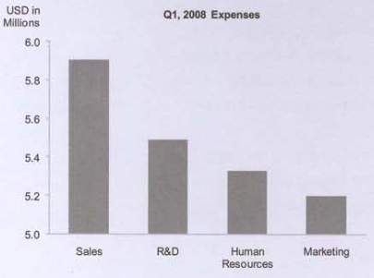
Bar Chart Guidelines, cont’d
A bar chart scale must begin at zero.
Sales expenses
are not 4½ times
marketing expenses.
Now You See It
by Stephen Few
Analytics Press, 2009

Slide 10
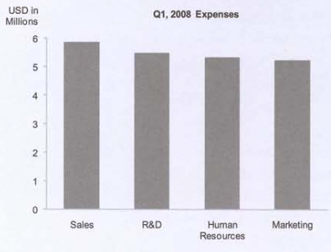
Bar Chart Guidelines, cont’d
Our eyes perceive differences, not absolute values.
We perceive differences proportionally.
Now You See It
by Stephen Few
Analytics Press, 2009

Slide 11
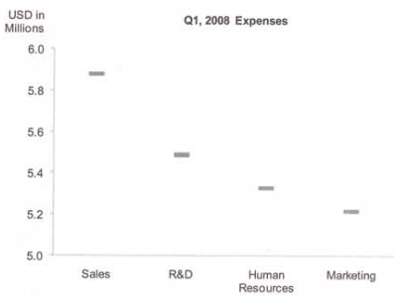
Displaying Differences
Use a dot plot to display differences in quantitative values.
Does not have to start at zero.
Narrow the range of the Y axis to more easily compare values.
Now You See It
by Stephen Few
Analytics Press, 2009

Slide 12
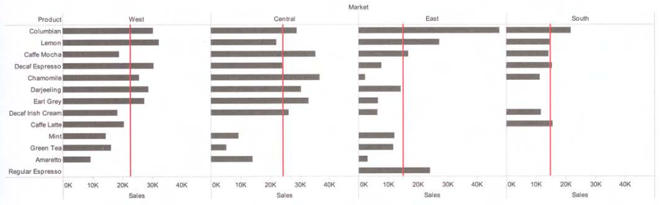
Bar Graph Reference Lines
Use reference lines to aid comparisons.
In these graphs, each reference line shows the average product sales
in that particular region only.
Now You See It
by Stephen Few
Analytics Press, 2009

Slide 13
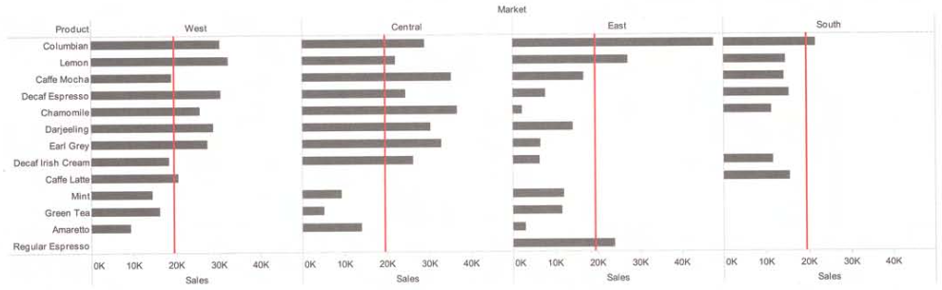
Bar Graph Reference Lines, cont’d
Each reference line is
the average product sales
across all regions.
Now You See It
by Stephen Few
Analytics Press, 2009

Slide 14
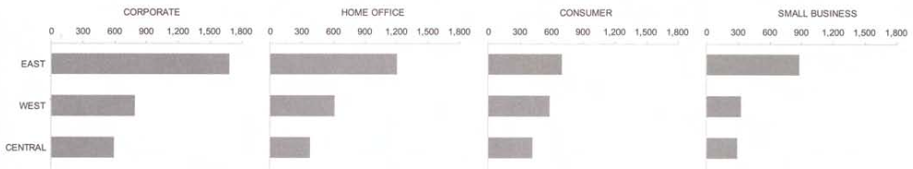
Bar Graphs as Small Multiples
Arranged horizontally.
Easy to track a specific region.
Now You See It
by Stephen Few
Analytics Press, 2009

Slide 15
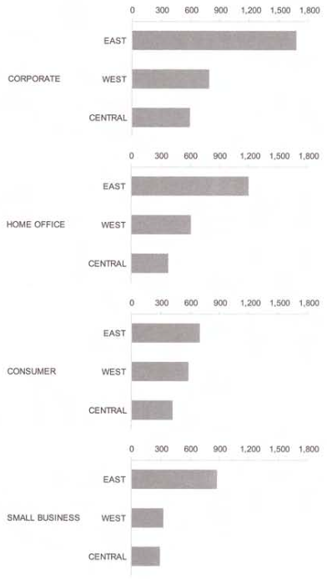
Bar Graphs as Small Multiples, cont’d
Arranged vertically.
Easy to compare
across all regions
and categories.
Now You See It
by Stephen Few
Analytics Press, 2009

Slide 16
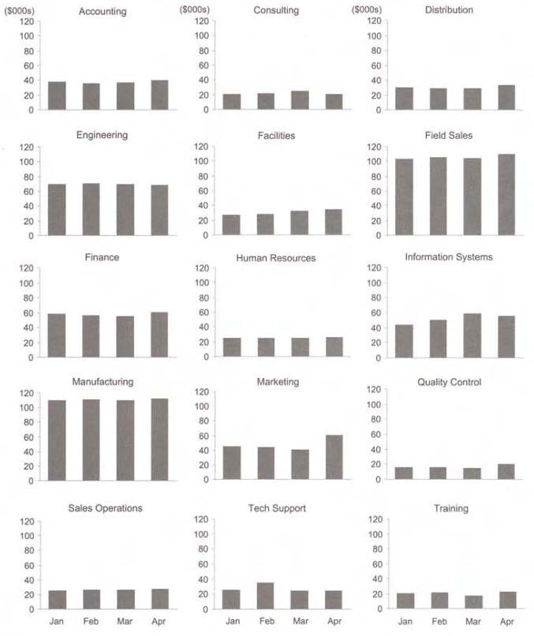
Bar Graphs as Small Multiples, cont’d
Arranged in a matrix.
Now You See It
by Stephen Few
Analytics Press, 2009

Slide 17
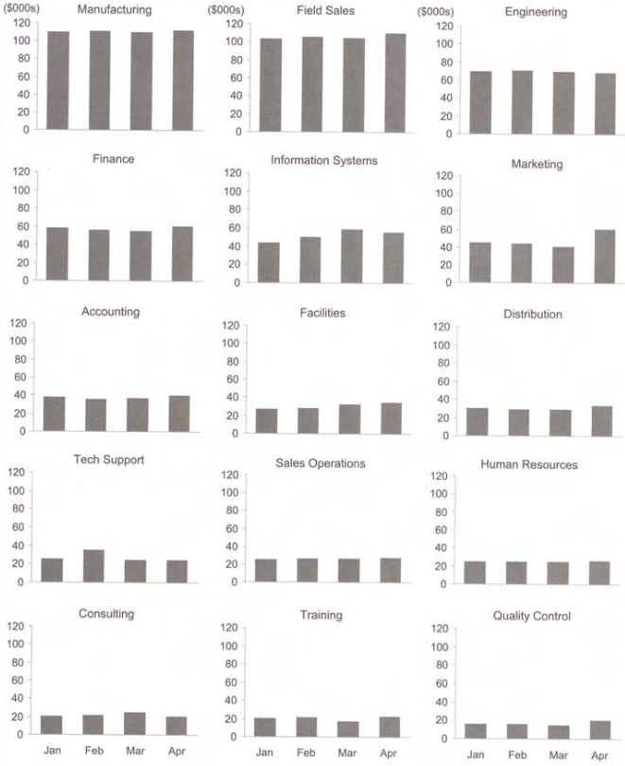
Bar Graphs as Small Multiples, cont’d
Sorted by magnitude.
Now You See It
by Stephen Few
Analytics Press, 2009

Slide 18
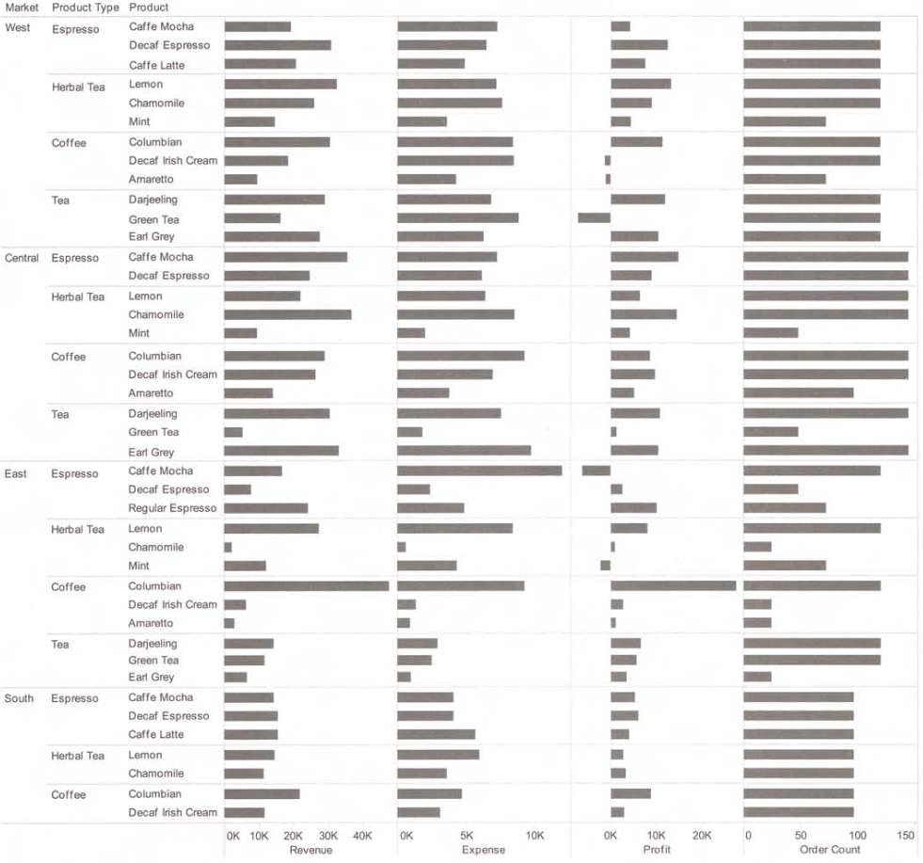
Bar Graphs in a Visual Crosstab Display
Examine sales
revenues,
expenses, and
profits together,
divided into
regions,
product types,
and products.
Now You See It
by Stephen Few
Analytics Press, 2009

Slide 19
In the Smooth and in the Rough
In the smooth
Values that are relatively typical of a dataset as a whole.
In the rough
Values that are outside the normal range.
AKA outliers
Outliers are due to:
errors
extraordinary events
extraordinary entities

Slide 20
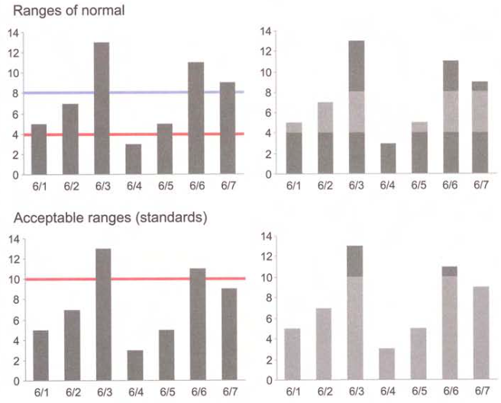
In the Smooth and in the Rough, cont’d
Now You See It
by Stephen Few
Analytics Press, 2009

Slide 21
Box Plots
What meanings come to mind when you see the following two divided rectangles?
The tops and bottoms are different.
The horizontal dividing lines are not aligned.

Slide 22
Box Plots, cont’d
Each box represents a range of values.
Bottom: The lowest value.
Top: The highest value.
The dividing line represents the mean (average) or median value.

Slide 23
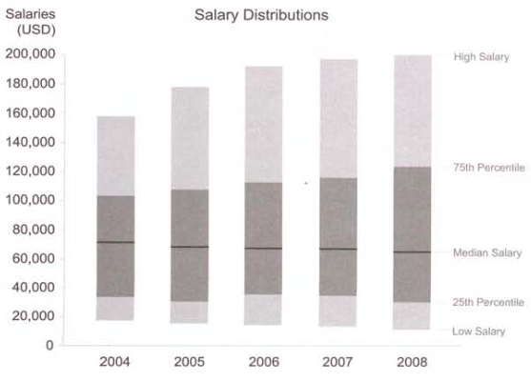
Box Plots, cont’d
Box plots can be very useful.
Now You See It
by Stephen Few
Analytics Press, 2009

Slide 24
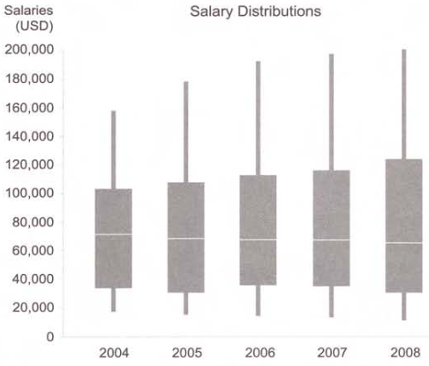
Box Plots, cont’d
Box plots as they are more typically drawn.
Now You See It
by Stephen Few
Analytics Press, 2009

Slide 25
Line Graphs
What does the following line suggest?
Lines show the shape of change from one value to the next.
Especially change through time (timeline).
Emphasize the overall trend and specific patterns of change in a set of values.

Slide 26
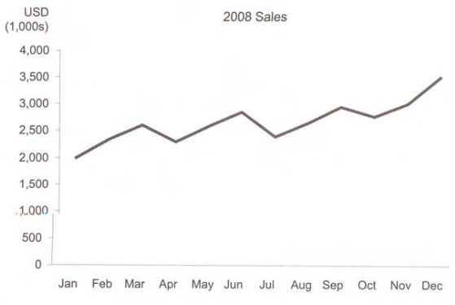
Line Graphs
Now You See It
by Stephen Few
Analytics Press, 2009

Slide 27
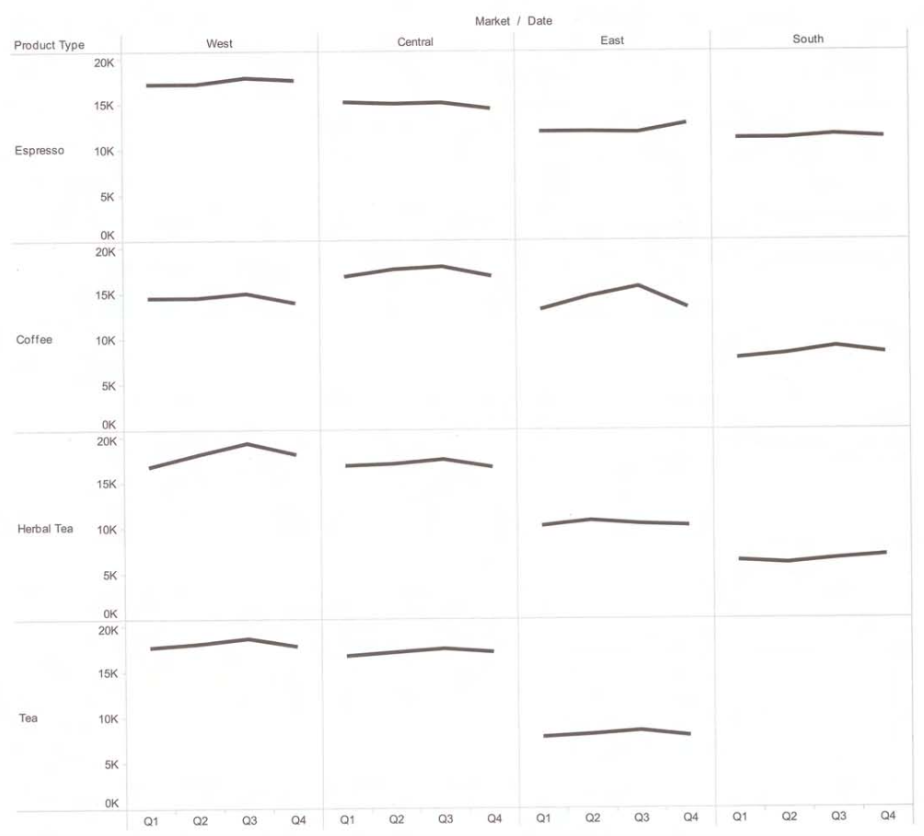
Line Graphs in a Crosstab
Now You See It
by Stephen Few
Analytics Press, 2009

Slide 28
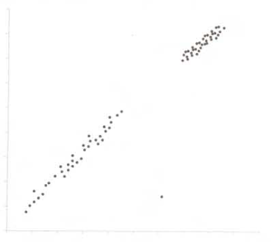
Scatterplots
What do the following points suggest?
Scatterplots encourage us to notice patterns:
clusters and gaps
linear or curved arrangements
points that appear isolated from the majority
Now You See It
by Stephen Few
Analytics Press, 2009

Slide 29
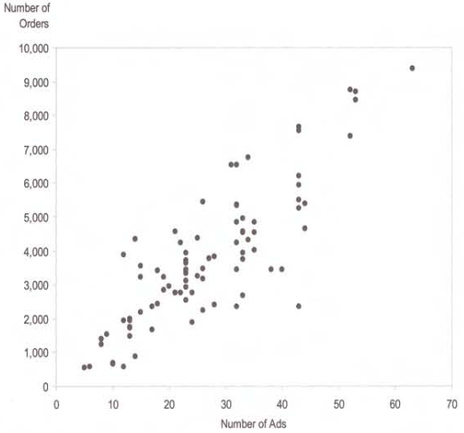
Scatterplots, cont’d
Each point can encode two quantitative values.
Horizontal position: x-axis value
Vertical position: y-axis value
Now You See It
by Stephen Few
Analytics Press, 2009

Slide 30
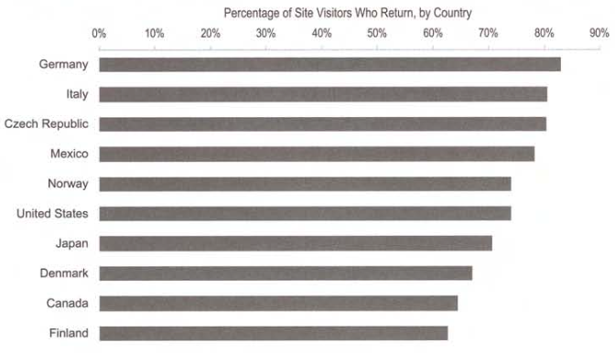
Scatterplots, cont’d
Replace a bar chart …
Must start
with 0%
Differences are
not as obvious
as they can be.
Now You See It
by Stephen Few
Analytics Press, 2009

Slide 31
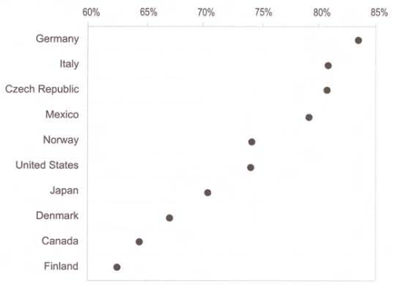
Scatterplots, cont’d
… with a dot plot
OK to narrow
the scale to
60% - 85%
Differences are
more obvious.
Now You See It
by Stephen Few
Analytics Press, 2009

Slide 32
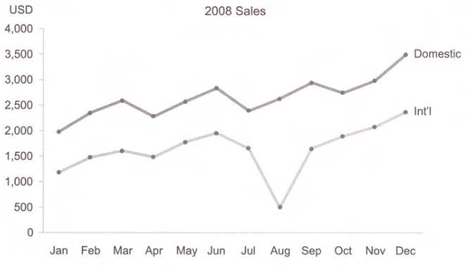
Points + Lines Combination
Use points and lines together in a line graph,
Clearly mark the actual positions of values.
Especially useful with more than one line.
Compare the magnitudes of values on different lines.
Now You See It
by Stephen Few
Analytics Press, 2009

Slide 33
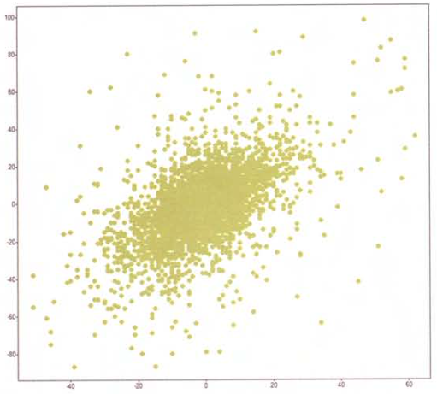
Over-Plotting Reduction
A scatterplot over-plotted with data points:
Now You See It
by Stephen Few
Analytics Press, 2009

Slide 34
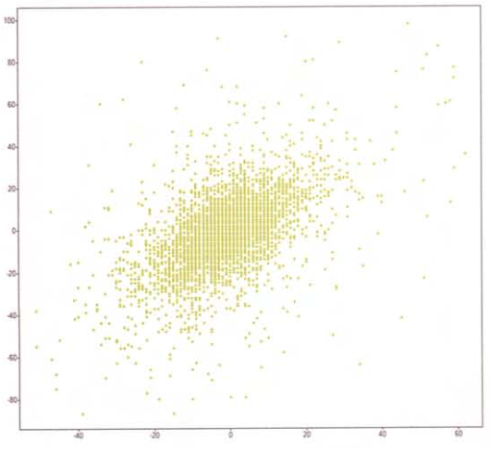
Over-Plotting Reduction, cont’d
Reduce the size of the dots:
Now You See It
by Stephen Few
Analytics Press, 2009

Slide 35
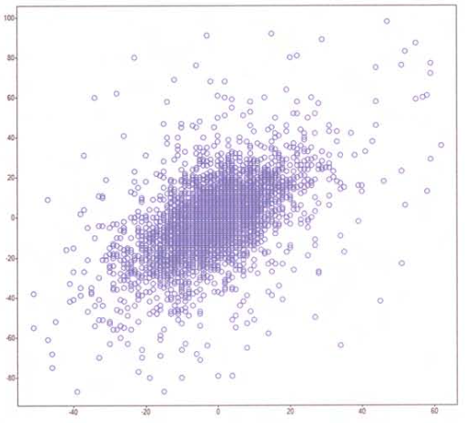
Over-Plotting Reduction, cont’d
Remove the dots’ fill color.
The dots stand out more clearly.
Now You See It
by Stephen Few
Analytics Press, 2009

Slide 36
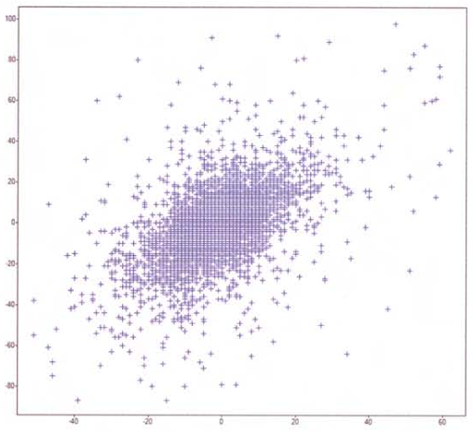
Over-Plotting Reduction, cont’d
Change the shape of the data objects.
Now You See It
by Stephen Few
Analytics Press, 2009

Slide 37
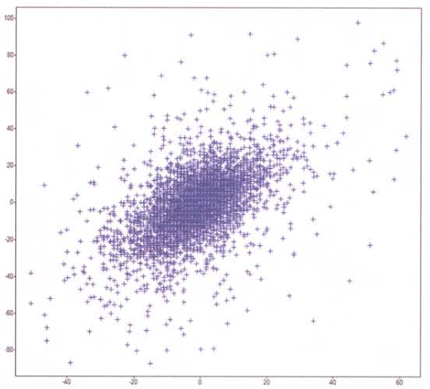
Over-Plotting Reduction, cont’d
Jitter the data objects.
Slightly alter the values so they are no longer the same.
Don’t jitter too much or you will create wrong patterns.
Now You See It
by Stephen Few
Analytics Press, 2009

Slide 38
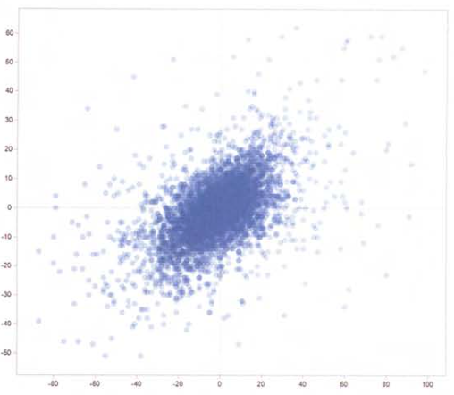
Over-Plotting Reduction, cont’d
Make data objects transparent.
Now You See It
by Stephen Few
Analytics Press, 2009

Slide 39
Over-Plotting Reduction, cont’d
Reduce the number of values.
Aggregate the data.
Filter the data.
Statistically sample the data.
Break the data into a series of separate graphs.

Slide 40
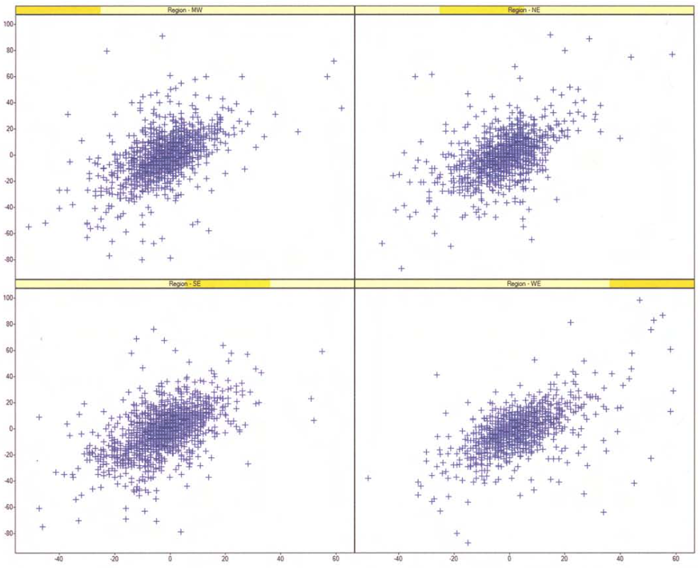
Over-Plotting Reduction, cont’d
Now You See It
by Stephen Few
Analytics Press, 2009

Slide 41
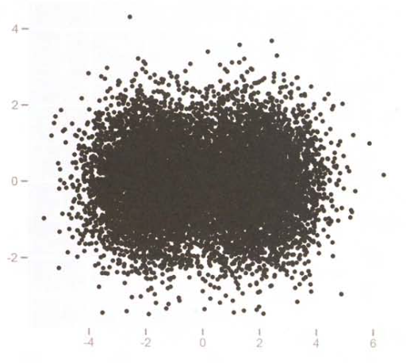
Encoding the Density of Values
Over-plotted:
Now You See It
by Stephen Few
Analytics Press, 2009

Slide 42
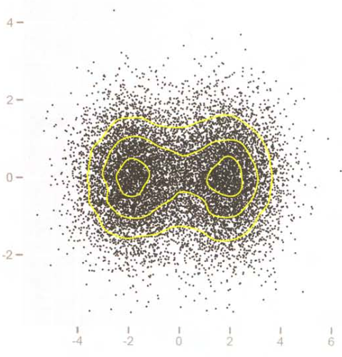
Encoding the Density of Values, cont’d
Add contour lines to differentiate between degrees of density.
Now You See It
by Stephen Few
Analytics Press, 2009

Slide 43
An Alternate Density-Encoding Method
Subdivide the scatterplot into a grid of small regions.
Display the number of data points in each region as colors of varying intensities.

Slide 44
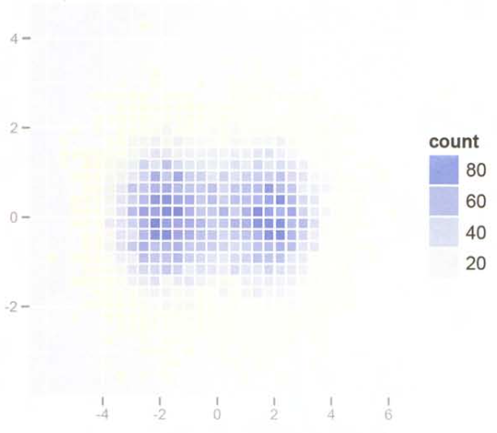
An Alternate Density-Encoding Method, cont’d
“Heat maps”
Now You See It
by Stephen Few
Analytics Press, 2009

Slide 45
Types of Analyses
Time series
Ranking and Part-to-Whole
Deviation
Distribution
Correlation
Multivariate
Ultimate goal:
Provide insight
for the user.
Users want
actionable
knowledge.

Slide 46
Time Series Analysis
Visualize how data changes through time.
Time provides an important context for understanding data.
Six basic patterns:
Trend
Variability
Rate of change
Co-variation
Cycles
Exceptions

